Slide 1
Heart Disease Diagnostic Tool
Predicting heart disease from clinical measurements
Machine Learning Capstone, Chapter 14, Project 4
Mozammel Hoque Sagor
Notes:
Good morning. This is Project 4 of my machine learning capstone: a tool that uses 13 clinical measurements to predict whether a patient has heart disease. It is a learning project and not a medical device. I will cover the problem, the data, my solution, the results and a short demo.

Slide 2
1. The Problem
Goal: predict from 13 clinical measurements whether a patient has heart disease
Missing a sick patient is worse than a false alarm
So the main measure is recall: the share of sick patients we find
A learning project, not a medical device
Notes:
The problem is to predict, from 13 clinical measurements such as age, maximum heart rate and chest pain type, whether a patient has heart disease. The two mistakes are not equal. Telling a sick patient that they are healthy is much worse than sending a healthy patient for another check. So the main measure is recall, the share of sick patients that the model finds. This is a learning project and not a medical device.

Slide 3
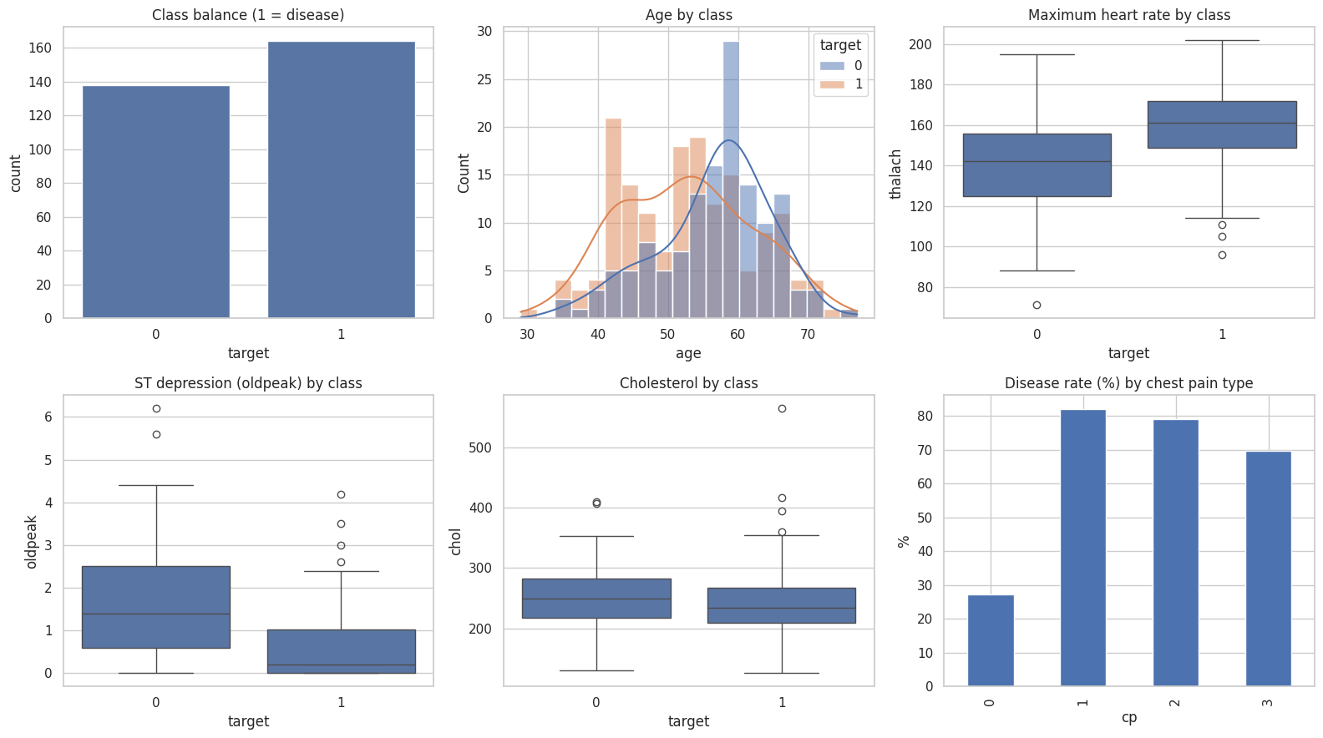
2. The Data
1,025 rows in the file
723 exact duplicates removed
302 distinct patients, 13 measurements
No missing values
164 patients with target 1, 138 with target 0
Caution: the label may be reversed in this file
Notes:
The data is a Kaggle copy of the UCI Heart Disease data. The file has 1,025 rows, but 723 of them are exact duplicates, so there are only 302 distinct patients. I removed the duplicates before splitting, so the same patient cannot be in both the training and the test set. There are no missing values. One caution: patients with target equal to 1 have a higher maximum heart rate and lower ST depression, which is the opposite of what is expected for heart disease. So the label may be reversed in this copy. I report the results for target equal to 1 exactly as it is in the file, and I have not verified the direction against the original UCI data.

Slide 4
3. The Solution
Duplicates removed first, so no patient is in both sets
241 patients to train, 61 to test
Four models: Dummy guess, Logistic Regression, SVM, Random Forest
SVM and Random Forest tuned with RandomizedSearchCV (25 trials)
Final model: SVM, best cross-validated ROC-AUC (0.923)
Alarm level (threshold 0.158) set on training data to favour recall
Notes:
First I removed the duplicate patients. Then I kept 241 patients for training and 61 for the final test. I compared four models: a Dummy guess that always says the most common class, a Logistic Regression, an SVM and a Random Forest. The SVM and the Random Forest were tuned with a random search of 25 settings, checked with 5-fold cross-validation on the training patients only. The SVM won on cross-validated ROC-AUC, 0.923 against 0.917. Because missing a sick patient is the worse mistake, I did not keep the usual 0.5 alarm level. I chose 0.158 on the training data, using a score that counts recall twice as much as precision. The test set was not used for any of these choices.

Slide 5
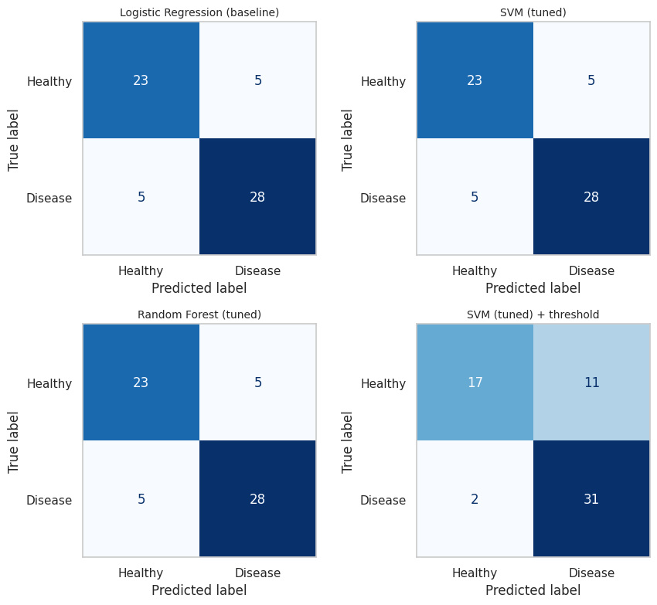
4. Business Impact
Model (test set) | Recall | Precision | F1 | AUC
Logistic Regression | 0.848 | 0.848 | 0.848 | 0.905
SVM | 0.848 | 0.848 | 0.848 | 0.917
Random Forest | 0.848 | 0.848 | 0.848 | 0.898
SVM + threshold (final) | 0.939 | 0.738 | 0.827 | 0.917
Final model finds 31 of 33 positive patients and misses 2
It raises 11 false alarms among 28 negative patients
At the usual 0.5 cut-off all three models are equal (28 of 33 found)
Only 61 test patients: one patient is about 3 points of recall
Label direction still to be verified
Test-set errors of each model
Notes:
These are the results on the 61 test patients, 33 of whom have target equal to 1. At the usual 0.5 alarm level, Logistic Regression, the SVM and the Random Forest all make the same mistakes: they find 28 of the 33 and wrongly flag 5 of the 28 others. With the lower alarm level, the final SVM finds 31 of the 33 and misses only 2, but it raises 11 false alarms among the 28 others, so precision falls to 0.738. That is the trade-off: fewer missed patients for more extra checks. With only 61 test patients, one patient moves recall by about 3 percentage points, so small differences should not be over-read. I did not estimate money saved, because that needs the real costs of a missed case and of an extra check. And the label direction in this file still has to be verified.

Slide 6
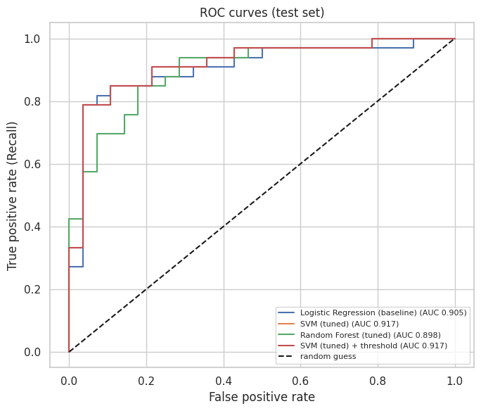
5. Demo and Next Steps
Demo
Run all cells in the notebook
Section 8 prints patients found, missed and false alarms
Test set: 31 found, 2 missed, 11 false alarms among 28
Next steps
Check the label against the original UCI data and re-run
More patients and a test on an outside dataset
Set the alarm level from real costs; serve with FastAPI
ROC curves: the models rank patients almost equally well
Notes:
This is the optional live demo. In the notebook, section 8 prints how many patients with target equal to 1 were found, how many were missed and how many false alarms there were: 31 found, 2 missed and 11 false alarms among 28 on the test set. On the right are the ROC curves, which show that the models rank patients almost equally well. Next steps: first check the label direction against the original UCI data and re-run the notebook, then get more patients and test on an outside dataset, choose the alarm level from the real costs of a missed case and an extra check, and serve the model through a FastAPI endpoint. Thank you. Questions?

